Slide 1
Responsible AI
Week 1: Introduction

Slide 2
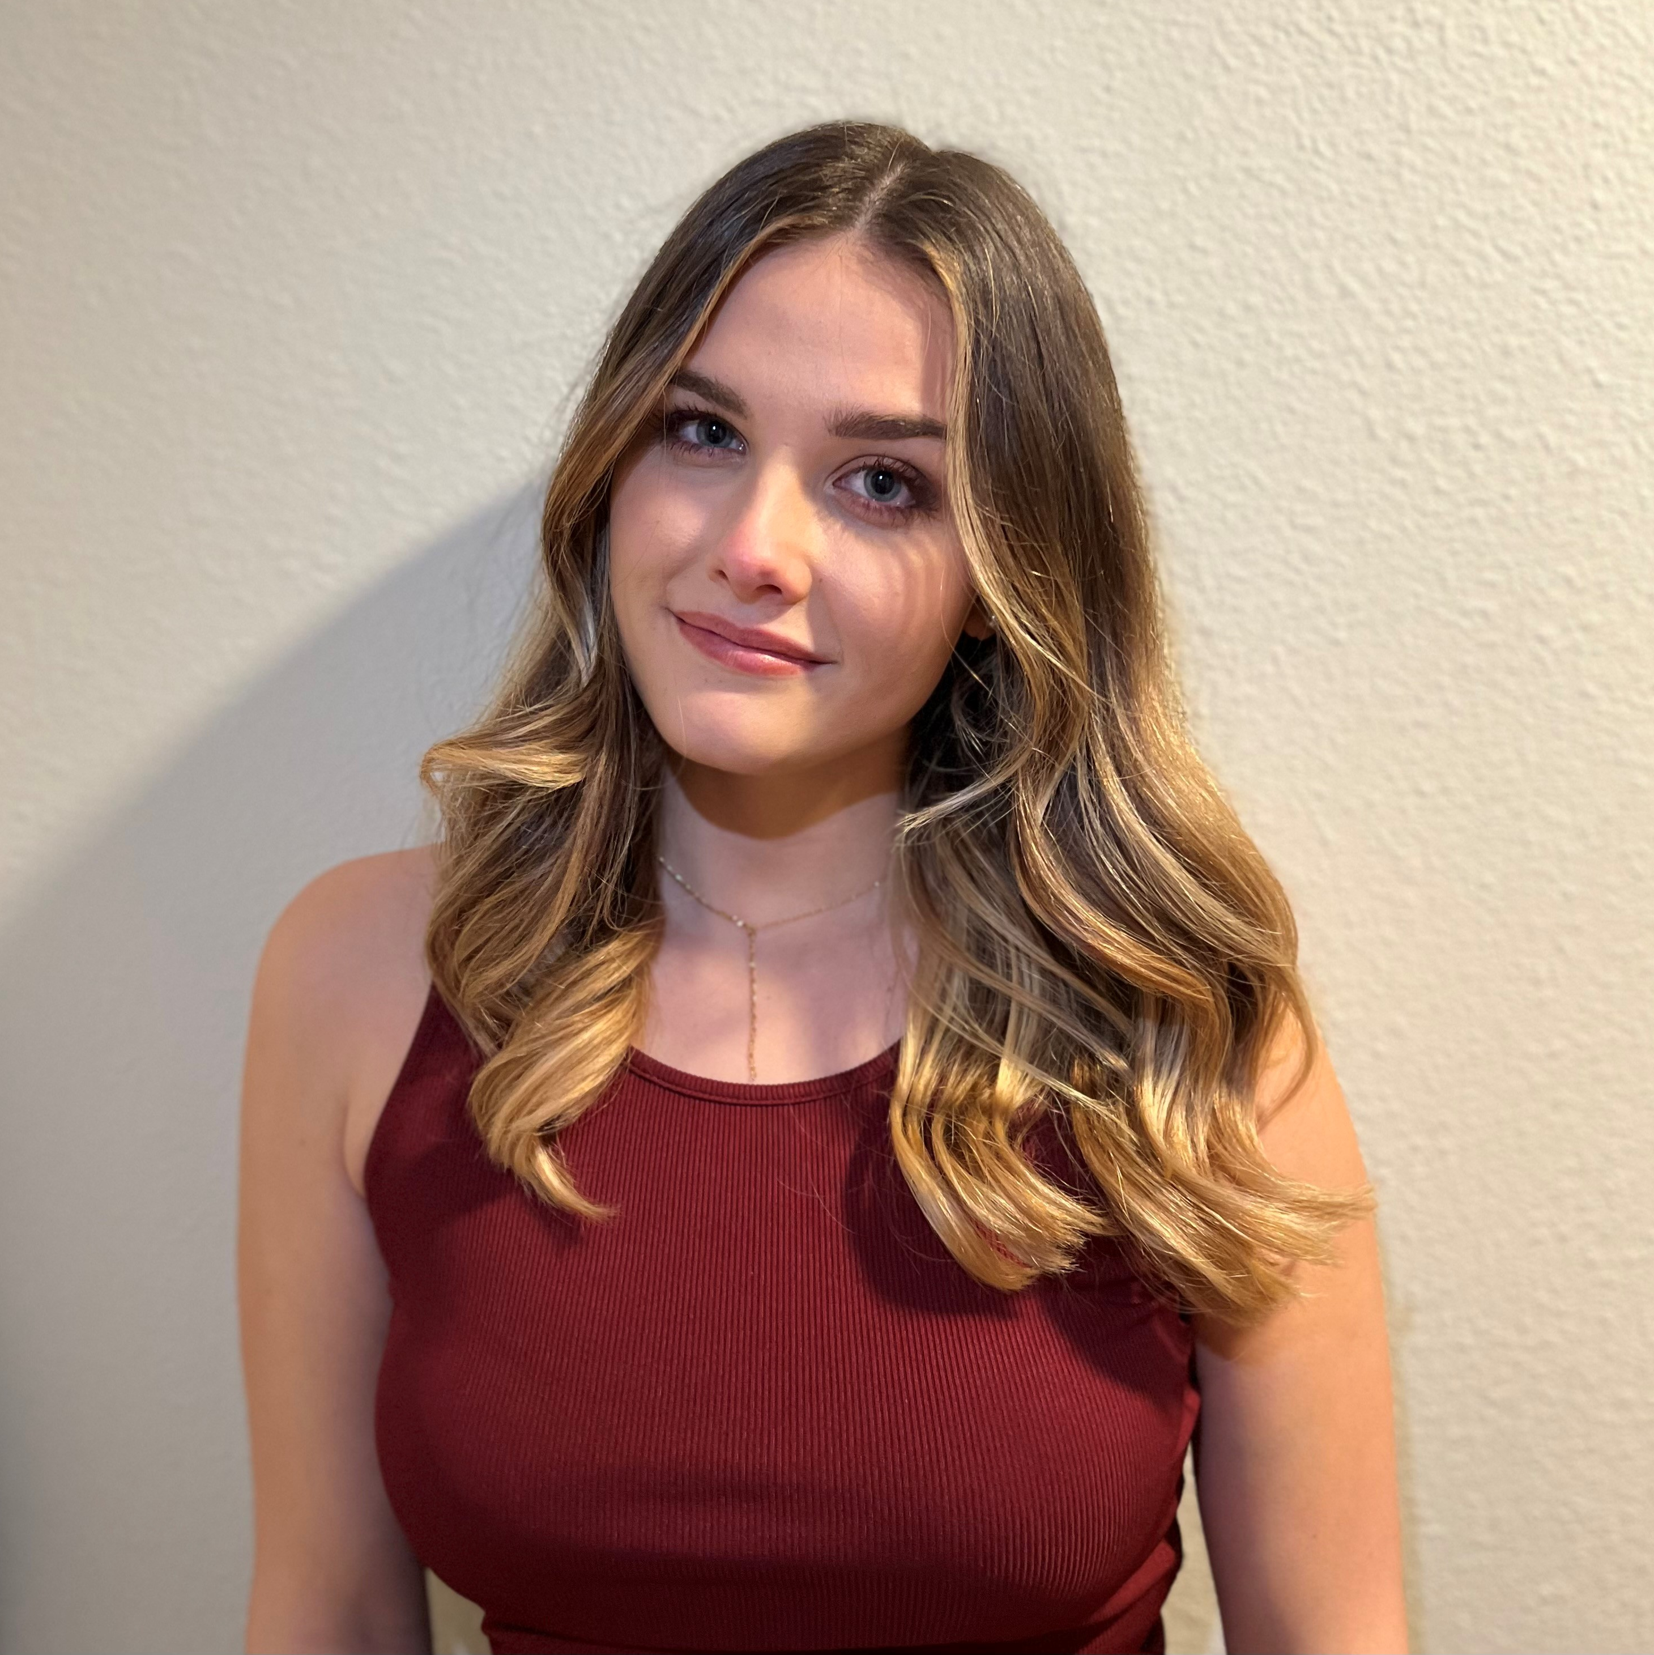


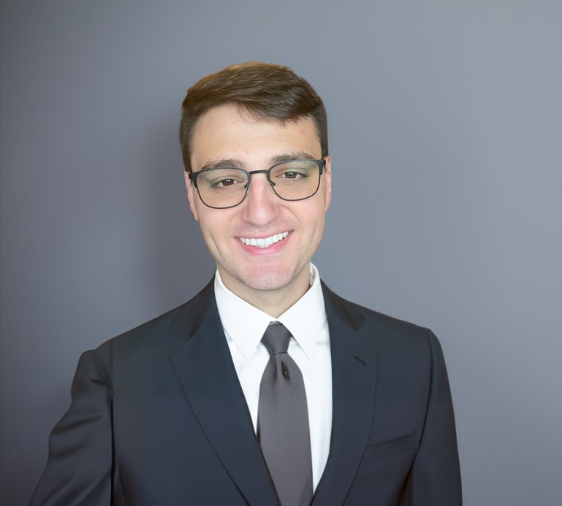

Course instructor INTRODUCTIONS
Emily Ramond (POC) eramond@deloitte.com
Gregory Thein gthein@deloitte.com
Stephanie Chavez stchavez@deloitte.com
Ryan Cummings rycummings@deloitte.com

Slide 3
Course objectives
The goal of this course is to help students understand and develop points of view on the answers to questions like:
What are the ways to think about whether an AI model is fair?
What does responsible AI mean for different stakeholders?
How do ethical problems in AI models affect human beings?
What are the risks of ‘black box’ algorithms, and how do we mitigate them?
How is AI explainability related to fairness?
What are some of the relevant regulations and/or industry standards for AI?
What are some of the challenges or limits of current AI fairness practices?

Slide 4
Course expectations
Participation (5%)
Students must submit a default participation questions (available on the course website) 24 hours before class.
Students are responsible for responding according to default participation if no assignment is given.
Prompts are due on Gradescope 24 hours prior to the start of each class session (Monday, 1:00pm PT)
Overall Participation (5%)
Each student is responsible for preparing one five-minute in-class brief on one of the academic papers assigned as readings sign-up here.
For extra long readings, feel free to skim for important content.
In addition: all Students are responsible for completing the readings in full prior to the start of each week’s session to facilitate productive class discussion. All readings will be freely available and linked in the course website.
Please see the Capstone Program Syllabus for a detailed description of the assignment weights and rubric.
Notes:
https://docs.google.com/spreadsheets/d/1gcP3F5r38STycGsbomv94cFXuxEGGImfSOr0jkGY5_4/edit?usp=sharing

Slide 5
Course expectations
Quarter One Project (65%)
Students will complete coding tasks related to the replication project and are also responsible for creating a final writeup.
Full details of the requirements for the Q1 project can be found in the Capstone Program Syllabus
Quarter Two Project Proposal (15%)
Students will develop a project proposal for Q2 based on their learnings and interests from the course readings and the replication project.
Full details of the requirements for the project proposal can be found in the Capstone Program Syllabus.
Please see the Capstone Program Syllabus for a detailed description of the assignment weights and rubric.

Slide 6
Course RESOURCES
Course Website
A course website containing our weekly class schedule, assignment timelines, participation questions, and other resources is available at: https://deloitte-capstone.github.io/responsible-ai/
Office Hours
Deloitte will hold office hours virtually [coming soon!]
We will be deciding office hours in class today.
Questions and Communications
Discord/Slack Channel link: https://discord.gg/hm2hndFgTf
Primary Course Contact, email Emily Ramond (eramond@deloitte.com)
Notes:
Link a when to meet with AJ’s availability.

Slide 7
Student introductions
Introduce yourself. Who are you and why did you select this domain within the capstone?
Talk about a time when AI/ML had a real-world impact on the life of you or someone you know.
What characteristics, in your opinion, does an AI system need to have in order to be “ethical”?

Slide 8
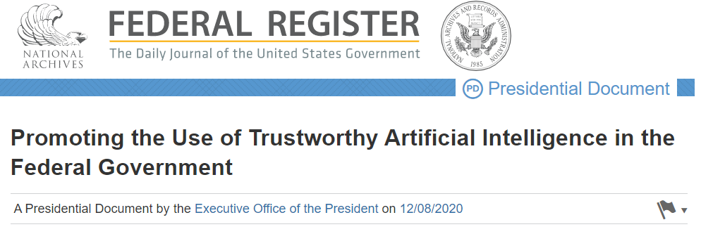
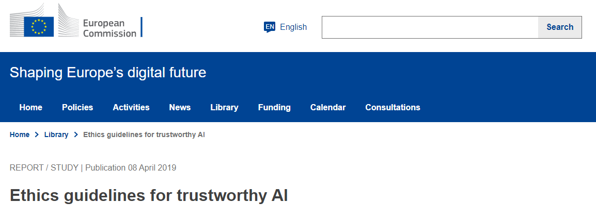
What is responsible* AI?
*Also called: ethical AI, trustworthy AI
Accountable
Transparent
Understandable
Regularly monitored
Responsible and traceable
Safe, secure, and resilient
Accurate, reliable, and effective
Purposeful and performance-driven
Lawful and respectful of our Nation's values
Accountability
Transparency
Human agency and oversight
Privacy and data governance
Technical robustness and safety
Societal and environmental well-being
Diversity, non-discrimination, and fairness
https://www.federalregister.gov/documents/2020/12/08/2020-27065/promoting-the-use-of-trustworthy-artificial-intelligence-in-the-federal-government
https://digital-strategy.ec.europa.eu/en/library/ethics-guidelines-trustworthy-ai

Slide 9
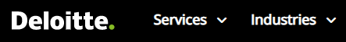


What is responsible AI?
Fair and impartial
Transparent and explainable
Responsible and accountable
Robust and reliable
Respectful of privacy
Safe and secure
Fairness
Explainability
Transparency
Robustness
Privacy
Avoid creating or reinforcing unfair bias
Be accountable to people
Incorporate privacy design principles
Be built and tested for safety
Be socially beneficial
Uphold high standards of scientific excellence
Be made available for uses that accord with these principles
https://www2.deloitte.com/us/en/pages/deloitte-analytics/solutions/ethics-of-ai-framework.html
https://www.ibm.com/cloud/learn/ai-ethics
https://ai.google/principles/

Slide 10
DISCUSSION
You will receive a short description of an AI scenario. Take five minutes to discuss the use case, focusing on potential ethical considerations and impacts.
Select one member of your group to share your team’s scenario and some of the ethical considerations you identified with the larger group.

Slide 11
SCENARIO 1
You are an AI practitioner working on the HR team for a tech startup. Your company wants to make their hiring process faster and less prone to human bias, so they ask you to build an automatic resume-screening tool. You decide to train this tool on the resumes of individuals who have been successful at your company, so it will identify similar individuals in the future. Since you only have a few employees, you also search LinkedIn for individuals with the same job at different companies and scrape their resume information. With this larger dataset, you build a resume-screening model. Your company deploys this model as the first step in your new hiring process; individuals who make it past the resume screen are then interviewed by humans on your team.
What ethical considerations can you think of related to building and deploying the AI tool in this scenario?
Inspired by:
https://www.reuters.com/article/us-amazon-com-jobs-automation-insight/amazon-scraps-secret-ai-recruiting-tool-that-showed-bias-against-women-idUSKCN1MK08G
https://hbr.org/2019/05/all-the-ways-hiring-algorithms-can-introduce-bias

Slide 12
SCENARIO 2
You are a landlord in a large city. Tenants at one of your high-rise properties have been complaining that their packages are frequently being stolen from the building’s common areas. To address this, you decide to purchase facial recognition software from an external vendor. You plan to install face scanners outside of the building’s entrances that are trained to recognize your tenants and refuse entry to anyone else. To set up your system, you ask your tenants to upload a well-lit picture of their face to the AI vendor’s website. The vendor will save the tenant photos as approved building residents, and the system will scan the faces of everyone who tries to enter the building against that list going forward.
What ethical considerations can you think of related to building and deploying the AI tool in this scenario?
Inspired by:
https://www.nytimes.com/2019/03/28/nyregion/rent-stabilized-buildings-facial-recognition.html

Slide 13
FOR NEXT WEEK
Sign up for an in-class brief by 10AM on Monday, October 9
Complete next weeks reading
If you sign up to present next week's reading, come prepared to present by 2:00PM PT on Tuesday, October 8th
Presentations are 5 minutes – short and simple. You are not graded on the slides and do not need to send them to me.
Submit your answers to next week’s participation questions to Gradescope by 1PM PT on Monday, October 8th
Review class website and email any questions to Emily Ramond (eramond@ucsd.edu)
Explore replication project and think about team assignments. First week office hours are meant to meet team members. Email me with any questions or concerns.
Please see the UCSD Capstone Syllabus and the Capstone Program Website for a detailed description of the assignment weights and rubric.

